Slide 1

Accelerate Deep Learning Inference using Intel® Technologies
Introduction
Smart Video

Slide 2
Optimization Notice
Intel’s compilers may or may not optimize to the same degree for non-Intel microprocessors for optimizations that are not unique to Intel microprocessors. These optimizations include SSE2, SSE3, and SSSE3 instruction sets and other optimizations. Intel does not guarantee the availability, functionality, or effectiveness or any optimization on microprocessors not manufactured by Intel. Microprocessor-dependent optimizations in this product are intended for use with Intel microprocessors. Certain optimizations not specific to Intel microarchitecture are reserved for Intel microprocessors. Please refer to the applicable product User and Reference Guides for more information regarding the specific instruction sets covered by this notice. Notice Revision #20110804

Slide 3
Legal Notices and Disclaimers
Intel technologies’ features and benefits depend on system configuration and may require enabled hardware, software or service activation. Performance varies depending on system configuration. No computer system can be absolutely secure. Check with your system manufacturer or retailer or learn more at www.intel.com.
Performance estimates were obtained prior to implementation of recent software patches and firmware updates intended to address exploits referred to as "Spectre" and "Meltdown." Implementation of these updates may make these results inapplicable to your device or system.
Cost reduction scenarios described are intended as examples of how a given Intel-based product, in the specified circumstances and configurations, may affect future costs and provide cost savings. Circumstances will vary. Intel does not guarantee any costs or cost reduction.
This document contains information on products, services and/or processes in development. All information provided here is subject to change without notice. Contact your Intel representative to obtain the latest forecast, schedule, specifications and roadmaps.
Any forecasts of goods and services needed for Intel’s operations are provided for discussion purposes only. Intel will have no liability to make any purchase in connection with forecasts published in this document.
ARDUINO 101 and the ARDUINO infinity logo are trademarks or registered trademarks of Arduino, LLC.
Altera, Arria, the Arria logo, Intel, the Intel logo, Intel Atom, Intel Core, Intel Nervana, Intel Xeon Phi, Movidius, Saffron and Xeon are trademarks of Intel Corporation or its subsidiaries in the U.S. and/or other countries.
*Other names and brands may be claimed as the property of others.
Copyright 2018 Intel Corporation.

Slide 4
Legal Notices and Disclaimers
This document contains information on products, services and/or processes in development. All information provided here is subject to change without notice. Contact your Intel representative to obtain the latest forecast, schedule, specifications and roadmaps.
Intel technologies’ features and benefits depend on system configuration and may require enabled hardware, software or service activation. Learn more at intel.com, or from the OEM or retailer. No computer system can be absolutely secure.
Tests document performance of components on a particular test, in specific systems. Differences in hardware, software, or configuration will affect actual performance. Consult other sources of information to evaluate performance as you consider your purchase. For more complete information about performance and benchmark results, visit http://www.intel.com/performance.
Cost reduction scenarios described are intended as examples of how a given Intel-based product, in the specified circumstances and configurations, may affect future costs and provide cost savings. Circumstances will vary. Intel does not guarantee any costs or cost reduction.
Statements in this document that refer to Intel’s plans and expectations for the quarter, the year, and the future, are forward-looking statements that involve a number of risks and uncertainties. A detailed discussion of the factors that could affect Intel’s results and plans is included in Intel’s SEC filings, including the annual report on Form 10-K.
The products described may contain design defects or errors known as errata which may cause the product to deviate from published specifications. Current characterized errata are available on request.
Performance estimates were obtained prior to implementation of recent software patches and firmware updates intended to address exploits referred to as "Spectre" and "Meltdown." Implementation of these updates may make these results inapplicable to your device or system.
No license (express or implied, by estoppel or otherwise) to any intellectual property rights is granted by this document.
Intel does not control or audit third-party benchmark data or the web sites referenced in this document. You should visit the referenced web site and confirm whether referenced data are accurate.
Intel, the Intel logo, Pentium, Celeron, Atom, Core, Xeon, Movidius, Saffron and others are trademarks of Intel Corporation in the U.S. and/or other countries. *Other names and brands may be claimed as the property of others.
© 2018 Intel Corporation.

Slide 5


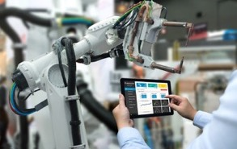


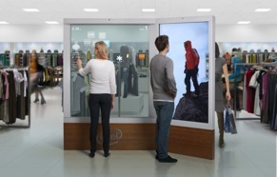

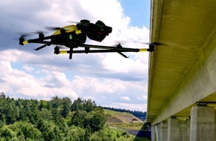
Emergency Response
Financial services
Machine Vision
Cities/transportation
Video: The “eye of IOT”
Use of video, computer vision and deep learning is growing rapidly
Autonomous Vehicles
Responsive Retail
Manufacturing
Public sector
Notes:
Advanced medical research, personalized healthcare, smart transportation, cities, manufacturing, retail, supply chain management—the industries that rely on video for critical insight and competitive growth are everywhere.
Up to $11 billion in edge to cloud industry growth is expected between now and 2021. Video captured at the edge by smart devices, sensors, and connected things represents a huge portion—$6 billion—of this IoT opportunity for everything from smart manufacturing to smart cities.

Slide 6
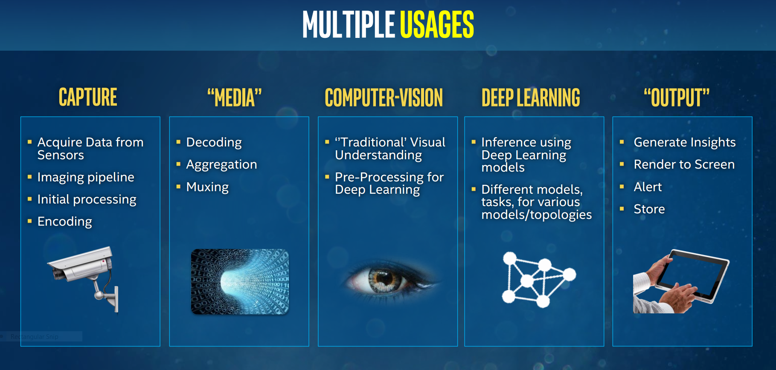

Slide 7
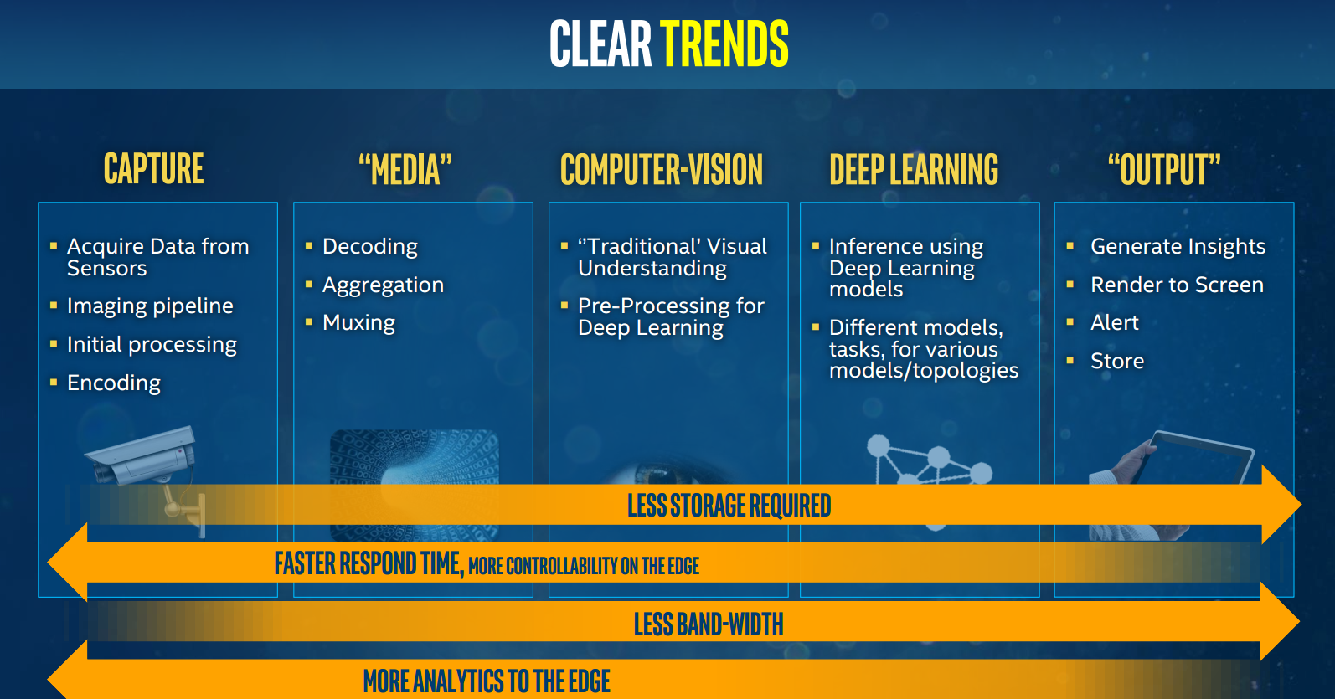

Slide 8
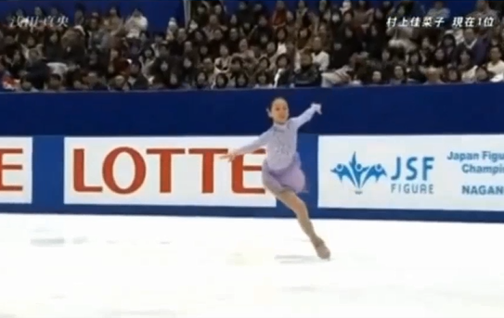

Deep Learning Usage is Increasing
Deep learning revenue is estimated to grow from $655M in 2016 to $35B by 2025¹
Image Recognition
Traditional Computer Vision Object Detection
Using Deep Learning
Error
Deep Learning Computer Vision person
recognition
person
Human
2010
Present
Market Opportunities + Advanced Technologies have Accelerated Deep Learning Adoption
¹Tractica 2Q 2017
Notes:
Slide Message: DL is often much more robust than conventional CV methods and hence much more accurate across a broader range of objects and scene conditions. The developer will need to assess whether the increased computation and robustness is required versus traditional CV methods for the particular use case

Slide 9
Deep learning: Training vs. inference
Training
Did you know?
Human
Bicycle
Training requires a very large data set and deep neural network (i.e. many layers) to achieve the highest accuracy in most cases
Forward
“Strawberry”
?
“Bicycle”
Lots of labeled data!
Backward
Error
Strawberry
Large NN
Inference
Model weights
Accuracy
Medium NN
Small NN
Traditional Model
Forward
“Bicycle”?
Data set size
??????
Notes:
In this presentation, we will often refer to the process of “training” a deep neural network (DNN) and the process of using the trained DNN for “inference”. This slide is meant to be a quick primer on the difference between the two.
In the example shown, the job of the DNN is to be able to classify the input picture into one of three different categories – a person, a bicycle, or a strawberry.
Lots of labeled training data is passed in to the network in a “forward pass”. With each new piece of training data, the network makes a prediction about what the image is. In the training example shown, the DNN predicts that the bicycle is a strawberry. So it has made an error.
In the “backward pass”, the error propagates back through the network and the weights – i.e., the interconnections between the artificial neurons – are updated to account for the error. Once these updates have been made, the next time the same image is passed into the DNN, the DNN will be more likely to predict that it’s a bicycle.
When the training process has been completed and the DNN is making predictions with sufficient accuracy, then the model weights are frozen, and the trained model can be used for inference.
The same types of operations that are done for training must also be done for inference. In fact, as we’ve explained, training involves inference! So you could certainly use a processor designed for training to do inference. However, the use cases of training and inference are not the same, which often implies different processor requirements.
With training, you want to run through a large number of computations on the order of exaflops (a billion billion operations!) as fast as possible, all at once. Training is typically done in a data center, where processor power and physical size are less of a constraint.
Inference, on the other hand, must happen over and over again as the trained model is in use over some extended period of time. There may be strict size or power constraints – for example if the inference is happening in a smartphone or a self-driving car.
So while you could use the same processor for inference as you do for training, sometimes using alternate designs is a more optimal approach for a given use case.

Slide 10
Artificial Intelligence Development Cycle
Dataset aquisition and organization
Import
Create Models
Build
Deploy
Train
Today’s focus:
Integrate trained models with application code
Adjust models to meet performance and accuracy objectives
Intel® Deep Learning Deployment Toolkit: Deploy optimized inference from Edge to Cloud
Notes:
Build
In order to achieve our vision for artificial intelligence, we must address each phase of the AI development cycle. Data scientists today are forced to spend unacceptable amounts of time preprocessing data, iterating on models and parameters, waiting for training to converge (compute-bound), and experimenting with deployment models, with each step being either too labor or compute intensive.

Slide 11














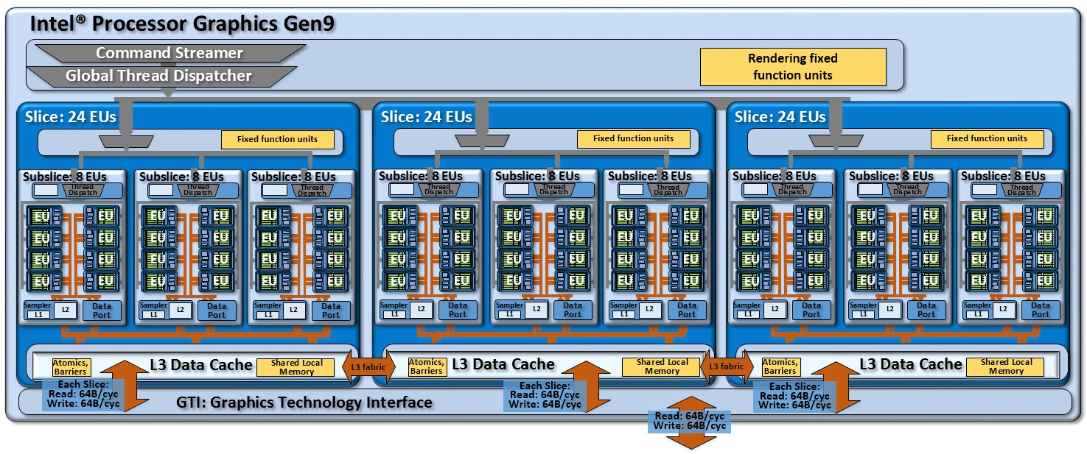
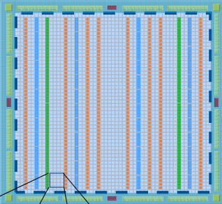



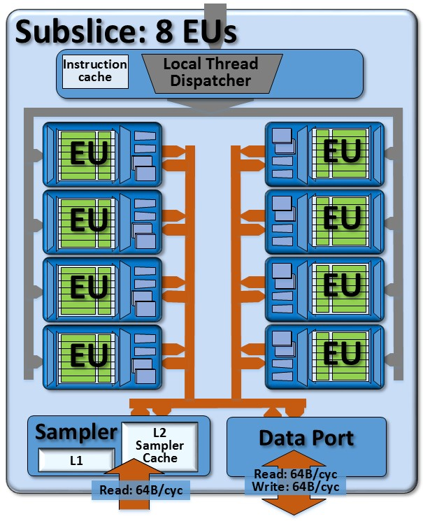
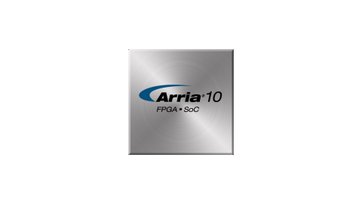
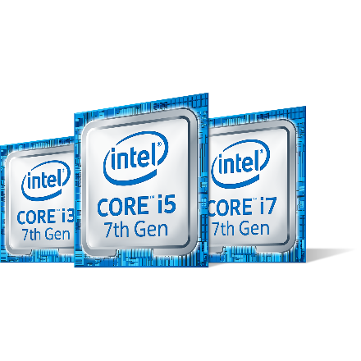


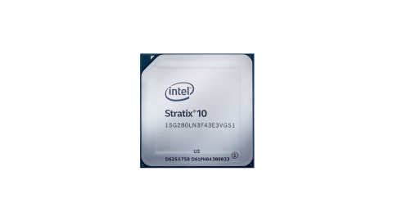
Industry trend: the Heterogeneous Era
CPU
Superscalar (SIMD)=1990s
Yesterday: apps run on single HW type
Today: apps are faster with multiple blocks
INT
INT
INT
FP
FP
CPU0
CPU1
Multicore = 2000s
CPU2
CPU3
Heterogeneous Era (today)
CPU Only
CPU+Gen Graphics
PSG FPGA
Machine Learning
And more!
Movidius
Notes:
Demo: encode is faster w/HW acceleration
Machine learning is faster with Gen and FPGAs as well as specialized HW
von Neumann architecture (1945)
Superscalar era (1990s)
Instruction level parallelism
Data level parallelism (SIMD)
Multicore era (2000s)
Homogeneous cores
Thread level parallelism
Diminishing returns
(Then things get interesting!)
5. Heterogeneous era (today)
Multiple engines – use best match for the job
OpenCL
Highly used, large, well defined operations candidates for FF: Codecs, img processing
Great performance/power advantages
Quick demo: show HW acceleration vs. CPU here to illustrate that the perf improvement is disruptive and hard to ignore. CPU is getting incremental perf improvements and power reductions.

Slide 12
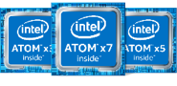
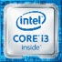
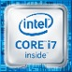
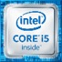



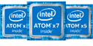
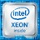

Intel IoT Video Portfolio Intel is investing in AI, computer vision and deep learning for IoT
Smart Cameras
Video Gateways/NVRs
Data center / Cloud
FPGA solutions from intel
CV
Intel® Media SDK, Intel® Computer Vision SDK
Industry’s Broadest Media and Computer Vision and Deep Learning Portfolio
Notes:
Intel is in a unique position provide the market with an E2E solution that addresses the pain points around bandwidth, storage cost, security, and real time response while also providing the right performance/watt for the DL workload that is needed to make systems predictive vs. forensic and support operational and business intelligence the market desires.
We have amassed the most complete silicon portfolio in the industry
Three key points:
Right silicon for every node
Security across every node
Common SW tools to Optimize perf across all nodes
from Camera to Cloud:
Edge (Camera)
Physical Constraints – Power and Size (small FF). Economical Constraints - Cost
Performance Efficiency – max performance within tight budgets
Latency – for Real-time use cases
Gateway/Recorder - as video aggregators, video gateways ingest and process multiple camera streams simultaneously (8-100s). Manufacturers are ramping support for more and more of those channels with AI processing.
Channel density - Performance/$
DC/Cloud – far less margin pressure – seeking high density media and DL throughput, with flexibility to scale.
Absolute Performance Throughput (images/S)
We have solutions across the entire system architecture
we will provide Flexibility: optimize tradeoffs for throughput, latency, and cost

Slide 13
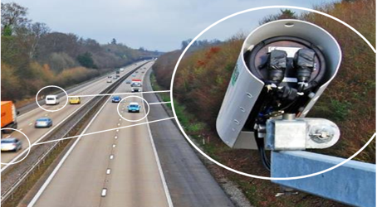
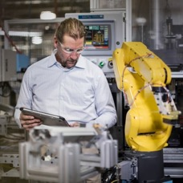
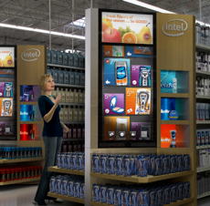
Intel IOT Video: Scaling Deep Learning & Analytics
Today Digital Security & Surveillance
2018+ Scaling to Industrial & Retail, Enabled by SW Tools
Intel® Computer Vision SDK
(Intel® CV SDK)
Notes:
Talking points/voiceover:
Our fastest growth (30%)+ has been in Video, largely led my media processing for things like traffic cameras and city monitoring, largely in China
Now, there are two critical strategic changes we are making to accelerate with the market:
It is critical to deliver AI-based acceleration technologies that integrate with all of our platforms
Video is becoming a key workload to integrate across all verticals – inventory and shopper monitoring in stores, machine inspection and robotics in industrial as examples
To achieve those goals – in 2018 we are delivering a set of tools and infrastructure to allow us to consolidate AI functions onto any intel platform and optimize those workloads on the appropriate product
HDDL software allows FPGA and Myriad products to be integrate onto any Intel platform and in many configurations, including multi-chip approaches for hungry workloads
The CVSDK is delivers accessible performance – where you or customers can take their existing deep learning and computer vision applications and port them to Intel CPU, GPU, FPGA or Movidius for maximum acceleration
The objective here is to deliver scalability to deliver the right level of price performance across all of our platforms and to be able to easily optimize the performance of all of your applications
The technology and products will be available starting in first half, then in second half, we will begin driving ecosystem programs through our channel

Slide 14


Intel® Computer Vision SDK & Components
What’s Inside the Intel® Computer Vision SDK
Intel® Deep Learning Deployment Toolkit
Component tools
Traditional Computer Vision–All SDK versions
Optimized Computer Vision Libraries
Model Optimizer Convert & Optimize
OpenCV*
OpenVX*
Increase Processor Graphics Performance–Linux* only
Trained Models
Intel® Media SDK (open source version)
OpenCL™ Intel® Integrated Graphics Drivers & Runtimes
IR
Inference Engine
Optimized Inference
Linux for FPGA only
FPGA RunTime Environment (RTE) (from Intel® FPGA SDK for OpenCL™)
Bitstreams
CPU
GPU
FPGA
VPU
GPU = CPU with Intel® Integrated Graphics Processing Unit
VPU = Movidius™ Vision Processing Unit
OpenVX and the OpenVX logo are trademarks of the Khronos Group Inc.
OpenCL and the OpenCL logo are trademarks of Apple Inc. used by permission by Khronos
Notes:
Intel® Computer Vision SDK is designed to increase performance and reduce time to market for computer vision solutions. It simplifies access to the benefits from the rich set of hardware options available from Intel which can increase performance, reduce power, and maximize hardware utilization – letting you do more with less and opening new design possibilities.
Deep Learning Deployment Toolkit
A Cross-platform Tool to Accelerate Deep Learning Inference Performance
Inference Engine, with plugins for CPU, GPU and FPGA – what it is… across multi-platform support
Model Optimizer, converting Caffe, TensorFlow, and MXnet to IR. (Note: TensorFlow and MXNet are preview only in R3.)
OpenCV
Pre-compiled OpenCV 3.3
Full Intel CPU optimizations
New Intel Photography Vision Library, with face detection/ recognition, blink detection, and smile detection
OpenVX
Graph-based implementation of a short list of traditional CV operations and CNN primitives.
Khronos OpenVX* Neural Networks Extension 1.2
Visual Algorithm Designer
Eclipse* plugin enabling integrated OpenVX* application development

Slide 15
Deep Learning vs. Traditional Computer Vision Intel® Computer Vision SDK has tools for an end to end vision pipeline
Intel® Computer Vision SDK
Intel® SDK for OpenCL™ Applications
Intel®
Media SDK
OpenCV*
OpenVX*
API Solution
API Solution
Direct Coding Solution
Pre-trained Optimized Deep Learning Models
Deep Learning Deployment Toolkit
Computer Vision Libraries
Custom Code
Model
Optimizer
Inference
Engine
Intel Hardware Abstraction
Layer
OpenCV*/OpenVX*
OpenCL™
C/C++
CPU
GPU
FPGA
VPU
CPU
GPU
CPU
GPU
DEEP LEARNING Computer Vision
TRADITIONAL Computer Vision
Based on application of a large number of filters to an image to extract features.
Features in the object(s) are analyzed with the goal of associating each input image with an output node for each type of object.
Values are assigned to output node representing the probability that the image is the object associated with the output node.
Based on selection and connections of computational filters to abstract key features and correlating them to an object
Works well with well defined objects and controlled scene
Difficult to predict critical features in larger number of objects or varying scenes
OpenVX and the OpenVX logo are trademarks of the Khronos Group Inc.
Notes:
Key Takeaways
CV SDK has tools for both Traditional and Deep Learning CV
Multiple Intel tools (Media SDK, CV SDK, ISS) work together to provide a complete CV pipeline optimization solution
Using CV SDK allows developer to maximize HW performance by using common API without having to go to the Metal
Easy to incorporate deep learning with the Deep Learning Deployment Toolkit
Trad. And DL are not mutually exclusive
OpenCL is used for:
required to run with GPU target (clDNN) using Intel® Processor Graphics
custom kernels
other kernels can be used for other non-inference pipeline stages, such as color conversions
Media SDK – API to access intel Quick Sync Video – hw accelerated encoding, decoding and processing
H.265, H.264, MPEG-2 and more
Resize, scale, deinterlace, color conversion,, composition, denoise, sharpen and more
Outstanding perf., rich API to tune pipeline, support new proc. w/o code change

Slide 16
Intel® Deep Learning Deployment Toolkit Take Full Advantage of the Power of Intel® Architecture
Model Optimizer
What it is: Preparation step -> imports trained models
Why important: Optimizes for performance/space with conservative topology transformations; biggest boost is from conversion to data types matching hardware.
Inference Engine
What it is: High-level inference API
Why important: Interface is implemented as dynamically loaded plugins for each hardware type. Delivers best performance for each type without requiring users to implement and maintain multiple code pathways.
Extendibility C++
Trained Model
Convert & optimize to fit all targets
Inference Engine
Common API (C++)
Optimized cross-platform inference
CPU Plugin
Extendibility OpenCL™
Caffe
Model Optimizer
Convert & Optimize
GPU Plugin
IR
Extendibility OpenCL/TBD
TF
IR
.data
Load, infer
FPGA Plugin
MxNet
Extendibility TBD
IR = Intermediate Representation format
Myriad Plugin
Notes:
CV SDK comes with the Deep Learning Deployment Toolkit. Inputting trained models from standard frameworks, such as Caffe, TensorFlow and MxNet, the Model Optimizer converts the inputed models in to a unified IR file that is then run on the Inference Engine.
Loading Caffe or other frameworks is not required if using standard layers or user provided custom layers.
Inference Engine takes the IR files and runs them. The API for the inference engine has abstracted the HW and is common across all HW types. This allows for testing across different accelerators without having to recode. The IE also allows heterogeneity by providing fallback from custom layers on a FPGA to the CPU or Gen.

Slide 17
Improve Performance with Model Optimizer
Model Optimizer
Analyze
Intermediate Representation (IR) file
Quantize
Trained Model
Optimize topology
Accuracy & Statistics Report
Convert
Easy to use, Python*-based workflow does not require rebuilding frameworks.
Import Models from various frameworks (Caffe*, TensorFlow*, MXNet*, more are planned…)
More than 100 models for Caffe, MXNet and TensorFlow validated.
IR files for models using standard layers or user-provided custom layers do not require Caffe
Fallback to original framework is possible in cases of unsupported layers, but requires original framework
OpenVX and the OpenVX logo are trademarks of the Khronos Group Inc.
Notes:
The redesigned Model Optimizer software is implemented as Python code, replaces the previous solution entirely and offers new features: - entirely new workflow, at the same time simplified and not requiring User to rebuild Caffe, etc.
- Windows support;
- Caffe is not required to generate IRs for models consisting of Standard Layers, OR when user already provides his custom layers; - fallback to original framework is possible in case of unsupported layers (then framework is required);
- additional optimizations generalized from existed in the old MO; - improved usability, stability and diagnostics capabilities; [no analyzer cap]
- total ~110 public models supported for Caffe, MXNet and TensorFlow frameworks – list is available on request;
The Model Optimizer is easier to install, and easier to use for optimizations
Improved performance and output
deep learning
written in easy Python language, more efficient workflow
using standard layers, get faster performance without the overhead of frameworks

Slide 18
Optimal Model Performance using the Inference Engine
Simple & Unified API for Inference across all Intel® architecture (IA)
Optimized inference on large IA hardware targets (CPU/GEN/FPGA)
Heterogeneity support allows execution of layers across hardware types
Asynchronous execution improves performance
Futureproof/scale your development for future Intel® processors
Applications/Service
Inference Engine Runtime
Inference Engine Common API
FPGA Plugin
Intel Math Kernel Library (MKLDNN)Plugin
clDNN Plugin
Movidius
Plugin
Plug-In Architecture
DLA
Intrinsics
OpenCL™
Movidius API
Intel® Arria 10 FPGA
CPU: Intel® Xeon®/Core™/Atom®
Intel® Integrated
Graphics(GPU)
Movidius™ Myriad 2
Transform Models & Data into Results & Intelligence
Notes:
Heterogeneity - Device affinities. User can specify (example) "HETERO: FPGA,CPU" to fallback to CPU for layers that FPGA does not support. This can also be used for CPU+GPU cases when User has custom layers implemented on CPU only and wants to execute rest of topology on GPU without obligation to rewrite the custom layer for GPU
Async API usage improves overall frame-rate of the application, allowing to do other things (like next frame decoding), while accelerator is busy with inference of the current frame.

Slide 19
Benefits of the Intel® Computer Vision SDK
Harness the Power of Intel® Processors: CPU, CPU with Integrated Graphics, FPGA,VPU
Accelerate Performance
Integrate Deep learning
Access Intel computer vision accelerators. Speed code performance. Supports heterogeneous processing & Asynchronous execution.
Unleash convolutional neural network (CNN) based deep learning inference across
Up to 10x increase*
using a common API & trained models.
speed development
Innovate & customize
Reduce time using a library of optimized OpenCV* & OpenVX* functions, 30+ samples, & 11 trained models.
Develop once, deploy for current & future Intel-based devices.
Use the increasing repository of OpenCL™ starting points in OpenCV* to add your own unique code.
¹10x performance increase comparing certain standard framework models vs. Intel-optimized models in the Intel®Deep Learning Deployment Toolkit. See Benchmarks slides.
Benchmark results were obtained prior to implementation of recent software patches and firmware updates intended to address exploits referred to as "Spectre" and "Meltdown". Implementation of these updates may make these results inapplicable to your device or system. For more complete information about performance and benchmark results, visit www.intel.com/benchmarks.
**Certain technical specifications and select processors/skus apply. See product site for more details.
OpenVX and the OpenVX logo are trademarks of the Khronos Group Inc.
OpenCL and the OpenCL logo are trademarks of Apple Inc. used by permission by Khronos
Notes:
Using a common api across CPU, GPU, FPGA and Movidius VPU allows for heterogeneity, fallback to CPU and/or GPU and no need to recode when testing on different HW.
10x improvement was achieved by GE when comparing a standard tensorflow model they were using for image classification vs. when they used the DLDT. This was achieved on a Xeon system and allowed GE to increase their performance without the need of adding discrete GPU cards.
Over, 40 models and samples are included in the package. In addition, there is a model downloader that will also download public models.
Easy way to create an operation that isn't covered by the IE out of the box. You can express that as a composition of existing IE ops or register the op in the MO and connect it to the entirely new IE layer in C++ or OpenCL. The existed layers have been reorganized to “core” (general primitives) and “extensions” (topology-specific, for example DetectionOutput for SSD). These “extensions” should be built and loaded explicitly.
Speed development – auto fallback to CPU/GPU for FPGA

Slide 20
Increase Deep Learning Performance on Public Models using the Intel® Computer Vision SDK (Intel® CV SDK) – Performance in Frames per Second (FPS)
Baseline Caffe* Framework - Out of Box = 100%
Or offload to Intel® Iris™ Pro Graphics, Freeing up the CPU for other tasks
Optimize it
Use Intel Tools
Public models | Batch Size |  | OpenCV* optimized (non-Intel) | Intel CV SDK on CPU |  | Intel CV SDK w/ Floating Point 16 (FP16)¹
Squeezenet* 1.1 | 1 |  | 431% | 425% |  | 564%
Vgg16* | 1 |  | 174% | 549% |  | 295%
GoogLeNet* v1 | 1 |  | 330% | 577% |  | 448%
SSD* 300 | 1 |  | 185% | 448% |  | 248%
Squeezenet* 1.1 | 32 |  | 466% | 759% |  | 663%
Vgg16* | 32 |  | 188% | 434% |  | 321%
GoogLeNet* v1 | 32 |  | 385% | 715% |  | 497%
Intel® Computer Vision SDK Accelerates Performance of Deep Learning Models running on Intel Hardware
→ Get Faster Results with Less Work
¹Accuracy changes can occur w/ FP16
Benchmark results were obtained prior to implementation of recent software patches and firmware updates intended to address exploits referred to as "Spectre" and "Meltdown". Implementation of these updates may make these results inapplicable to your device or system. For more complete information about performance and benchmark results, visit www.intel.com/benchmarks.
Configuration: Intel® Core™ i7-6700K CPU @ 2.90GHz fixed, GPU GT2 @ 1.00GHz fixed Internal ONLY testing, performed 4/10/2018 Test v312.30 – Ubuntu* 16.04, Intel® Computer Vision SDK 2018 RC4. Tests were based on various parameters such as model used (these are public), batch size, and other factors. Different models can be accelerated with different Intel hardeware solutions, yet use the same Intel software tools!
See full details in Backup Slide. Benchmark Source: Intel Corporation.
Intel’s compilers may or may not optimize to the same degree for non-Intel microprocessors for optimizations that are not unique to Intel microprocessors. These optimizations include SSE2, SSE3, and SSSE3 instruction sets and other optimizations. Intel does not guarantee the availability, functionality, or effectiveness of any optimization on microprocessors not manufactured by Intel. Microprocessor-dependent optimizations in this product are intended for use with Intel microprocessors. Certain optimizations not specific to Intel microarchitecture are reserved for Intel microprocessors. Please refer to the applicable product User and Reference Guides for more information regarding the specific instruction sets covered by this notice. Notice revision #20110804
Notes:
From worksheet 3.6 on 1/7/2018
Columns K, AB-AF
Tested topologies are split into 2 types: Public - topologies reported in papers and publicly available. Intel - topologies that are used @ Intel (either developed for customer enabling, own products or experimental results). Readiness of the topology indicates maturity of the product (Research->POC->Internal Reference-> Near Production Worthy-> Production Worthy) Testing methodology: - End 2 End. Each topology is passed through Model Optimizer and executed on target hardware for Inference Engine. For caffe, no modifications on model are done. - Results of execution are compared against caffe version. Error threshold is as follows: - 10e-4 for classification networks - 1 pixel difference in bounding box coordinates + 10e-4 difference in confidence for detection networks - Each network is executed for at least 20 seconds in a loop, minimum 10 executions done. Measured times are filtered to take 3 Sigma range. Other measurements are discarded. Out of remaining measurements, median value is taken. HW and SW details for targets are described in detail on System Configuration spreadsheet. Benchmark results in FPSes are reported on Benchmark results spreadsheet. Color codings are as follows: Fastest framework for target Results do not match caffe reference Test did not finish Test was not run Column descriptions: MaxMem is a theoretical memory consumption of the network for inference considering that memory is NOT reused, i.e. if all internal feature maps are stored in memory simultaneously. MinMem is absolute minimum of memory that network needs for inference. I.e. largest of needs from all layers. MaxMem and MinMem are measured in millions of activations (to get actual memory size multiply by activation size, i.e. fp16 for Movidius). Does not consider weights, those are shown in Mparam. Gflop number are actual operations, not MACs. Counted for known layers (mostly convolutions, FCs, etc.). Custom layers are not considered. Mparam numbers are reported for known layers only. Number is actual amount of parameters. To get amount of bytes number should be multiplied by size of weight (e.g. fp16 for Movidius). Input image is given as a size of first input blob for a network. Network execution time is split into times taken by individual layer types (Convolution, Pooling, etc.). Breakdown is reported for each topology, target and plugin on Execution breakdown spreadsheet. 100% correspond to entire network time. %% number indicates to relative number that individual layer type takes. Layer types and their parameters that are used by each topology are reported on Layers per toplogy list. Number on this sheet shows how many times particular layer with given parameters is used in a topology.

Slide 21
Increase Deep Learning Performance on Public Models using the Intel® Computer Vision SDK even MORE with FPGA Accelerator Cards (FPS)
Baseline Caffe* Framework - Out of Box = 100%
Optimize it
Use Intel Tools
Or offload to Intel® Iris™ Pro Graphics
Or offload to Intel® FPGA
Public models | Batch Size |  | OpenCV* optimized (non-Intel) | Intel® CV SDK on CPU |  | Intel CV SDK w/ Floating Point 16 (FP16)¹ |  | Intel CV SDK on Intel® Arria 10-1150GX FPGA
Squeezenet* 1.1 | 1 |  | 431% | 425% |  | 564% |  | 1,623%
Vgg16* | 1 |  | 174% | 549% |  | 295% |  | 435%
GoogLeNet* v1 | 1 |  | 330% | 577% |  | 448% |  | 1,619%
SSD 300* | 1 |  | 185% | 448% |  | 248% |  | 819%
Squeezenet* 1.1 | 32 |  | 466% | 759% |  | 663% |  | 2,016%
Vgg16* | 32 |  | 188% | 434% |  | 321% |  | 791%
GoogLeNet* v1 | 32 |  | 385% | 715% |  | 497% |  | 1,895%
Intel® Computer Vision SDK Accelerates Performance of Deep Learning Models running on Intel Hardware
→ Get Faster Results with Less Work
¹Accuracy changes can occur w/ FP16
Benchmark results were obtained prior to implementation of recent software patches and firmware updates intended to address exploits referred to as "Spectre" and "Meltdown". Implementation of these updates may make these results inapplicable to your device or system. For more complete information about performance and benchmark results, visit www.intel.com/benchmarks.
Configuration: Intel® Core™ i7-6700K CPU @ 2.90GHz fixed, GPU GT2 @ 1.00GHz fixed Internal ONLY testing, performed 4/10/2018 Test v312.30, Ubuntu* 16.04, Intel® Computer Vision SDK 2018 RC4. Tests were based on various parameters such as model used (these are public), batch size, and other factors. → Different models can be accelerated with different Intel hardeware solutions, yet use the same Intel software tools!
Benchmark Source Intel Corporation. See full details in Backup Slide
Intel’s compilers may or may not optimize to the same degree for non-Intel microprocessors for optimizations that are not unique to Intel microprocessors. These optimizations include SSE2, SSE3, and SSSE3 instruction sets and other optimizations. Intel does not guarantee the availability, functionality, or effectiveness of any optimization on microprocessors not manufactured by Intel. Microprocessor-dependent optimizations in this product are intended for use with Intel microprocessors. Certain optimizations not specific to Intel microarchitecture are reserved for Intel microprocessors. Please refer to the applicable product User and Reference Guides for more information regarding the specific instruction sets covered by this notice. Notice revision #20110804
Notes:
From internal benchmark worksheet 3.12.30
Tested topologies are split into 2 types: Public - topologies reported in papers and publicly available. Intel - topologies that are used @ Intel (either developed for customer enabling, own products or experimental results). Readiness of the topology indicates maturity of the product (Research->POC->Internal Reference-> Near Production Worthy-> Production Worthy) Testing methodology: - End 2 End. Each topology is passed through Model Optimizer and executed on target hardware for Inference Engine. For caffe, no modifications on model are done. - Results of execution are compared against caffe version. Error threshold is as follows: - 10e-4 for classification networks - 1 pixel difference in bounding box coordinates + 10e-4 difference in confidence for detection networks - Each network is executed for at least 20 seconds in a loop, minimum 10 executions done. Measured times are filtered to take 3 Sigma range. Other measurements are discarded. Out of remaining measurements, median value is taken. HW and SW details for targets are described in detail on System Configuration spreadsheet. Benchmark results in FPSes are reported on Benchmark results spreadsheet. Color codings are as follows: Fastest framework for target Results do not match caffe reference Test did not finish Test was not run Column descriptions: MaxMem is a theoretical memory consumption of the network for inference considering that memory is NOT reused, i.e. if all internal feature maps are stored in memory simultaneously. MinMem is absolute minimum of memory that network needs for inference. I.e. largest of needs from all layers. MaxMem and MinMem are measured in millions of activations (to get actual memory size multiply by activation size, i.e. fp16 for Movidius). Does not consider weights, those are shown in Mparam. Gflop number are actual operations, not MACs. Counted for known layers (mostly convolutions, FCs, etc.). Custom layers are not considered. Mparam numbers are reported for known layers only. Number is actual amount of parameters. To get amount of bytes number should be multiplied by size of weight (e.g. fp16 for Movidius). Input image is given as a size of first input blob for a network. Network execution time is split into times taken by individual layer types (Convolution, Pooling, etc.). Breakdown is reported for each topology, target and plugin on Execution breakdown spreadsheet. 100% correspond to entire network time. %% number indicates to relative number that individual layer type takes. Layer types and their parameters that are used by each topology are reported on Layers per toplogy list. Number on this sheet shows how many times particular layer with given parameters is used in a topology.

Slide 22




Intel® Media SDK
API to access Intel® Quick Sync Video – hardware accelerated encoding, decoding & processing
Benefits
Outstanding performance
Rich API to tune encoding pipeline
Future proofed: support new processor without code changes
H.265 (HEVC)
H.264 (AVC)
MPEG-2 and more
Resize, Scale, Deinterlace
Color Conversion, Composition
Denoise, Sharpen and more
Targeting Digital Security & Surveillance, Connected Car Applications, and more
Smart Camera
Embedded Linux
using
and
Car Infotainment &
Cluster Display
Atom®, Pentium® and Celeron® ¹
¹ Intel® Celeron® Processor N3350, Intel® Pentium® Processor N4200, Intel® Atom® E3930, E3940, E3950 processors

Slide 23
Theory of Operation: Intel® Media SDK / Intel® Media Server Studio
Initialization
Media accelerator framework
Codec based
High level/parameter interface
3 operations
Good option for:
Accelerated video encode, decode
(and short list of frame processing)
Parameters (from header)
Parameters
(in & out)
Parameters
init
init
init
Main loop
Decode
VPP
Encode
stream
frame
frame
stream
More Information
Media Server Studio
Media SDK
Intel Media Code Samples
Out of scope:
* audio, containers, networking…
Notes:
CVSDK provides inference and traditional CV operations, but another big bottleneck in many applications is codec processing. Encode for streaming out can be especially expensive.
Programming model: Media SDK is a high level framework enabling video codecs
does just 3 things. Encode, decode, and VPP (frame processing)
Init stage: You supply params to the framework
Main loop: specify how pointers move between stages.

Slide 24
OpenCL™
OpenCL is used for:
required to run with GPU target (clDNN) using Intel® Processor Graphics
custom kernels
other kernels can be used for other non-inference pipeline stages, such as color conversions
Application
other kernels (filters, etc.)
Intel® CVSDK
clDNN
custom kernels
OpenCL API
Khronos ICD
Compiler
Runtime
Front End (Clang)
SPIR
Back End (LLVM)
Intel® Processor Graphics

Slide 25
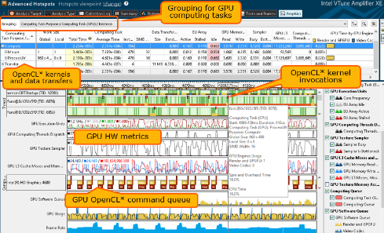
GPU Profiling for Linux* and Windows* Hardware and OpenCL* Metrics
Intel® Integrated Graphics hardware metrics
Details OpenCL™ activity on the GPU
Correlated with CPU processes and threads
Now on Linux* and Windows*
* See this Getting Started article

Slide 26
Smart video Workshop Overview
Introduction
2. Basic End to End Object Detection Example
Classification
Introduction to Intel® technologies for deep learning inference
Hardware acceleration techniques
H/W Acceleration
3,4,5. HW Acceleration with CPU, Integrated GPU, Intel® Movidius™ NCS, FPGA
Each Module contains a hands-on lab exercise that will introduce to various Intel technologies to accelerate computer vision application with hardware heterogeneity.
6. Optimization Tools and Techniques
Optimization
7. Advanced Video Analytics
Application

Slide 28





Target Markets & Use Cases
Retail
Industrial
+ retail, industrial automation, etc
$$
Office Automation
Optical Recognition
Image Recognition
Print Imaging
Autonomous Vehicles Lane Detection
Object Recognition
Common Use Cases & Workloads
Leveraging a heterogeneous compute environment
Processing images and videos
Managing domain-specific workloads (ie detecting lanes/license plates, parking lot monitoring, face recognition, etc.)

Slide 29
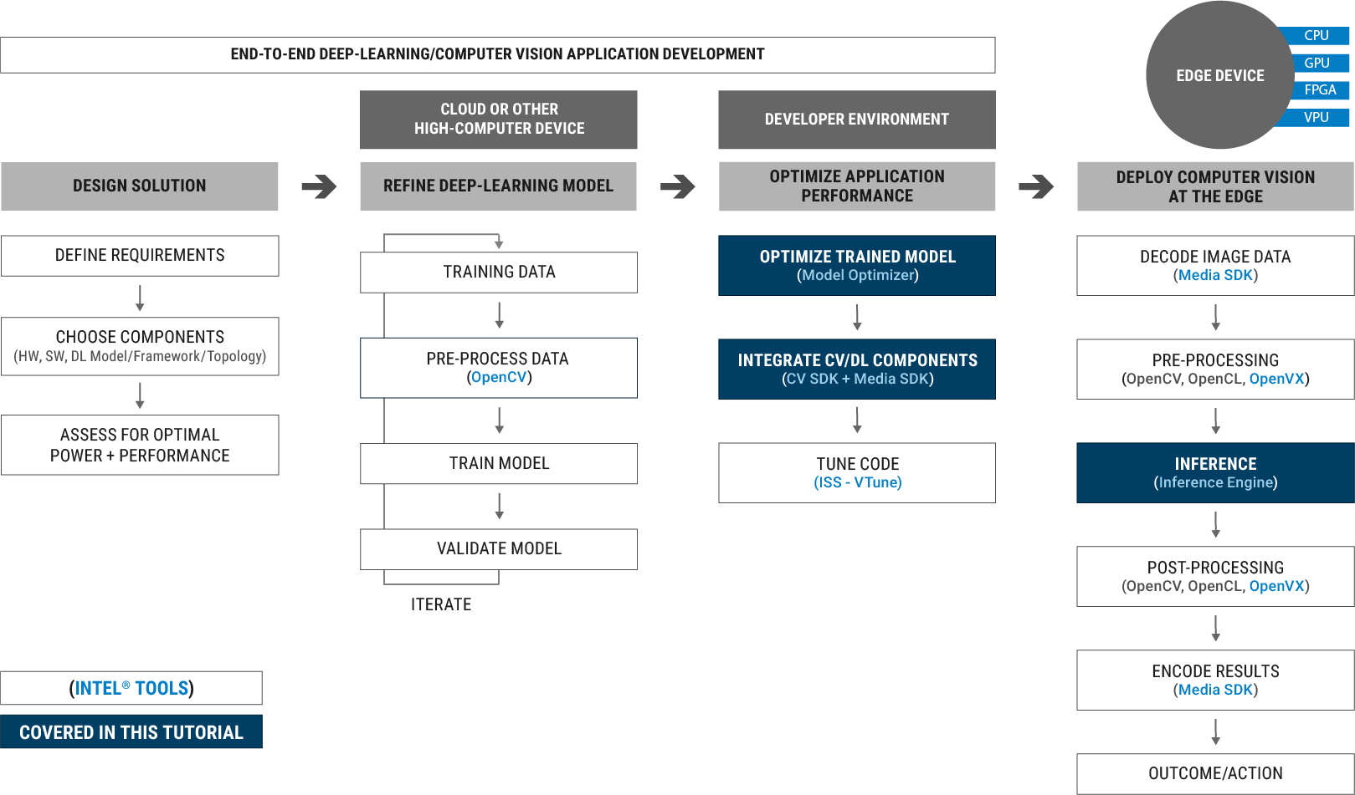
End 2 End CV Application Development Flow

